Slide 1
Chris Mullen
10387763
Project Presentation
Hologram Compression Using The ffmpeg Standard

Slide 2
Project Goals
Find a method to compress a collection of holograms with good reduction in storage size and acceptable level of quality reduction using variants of the ffmpeg standard
Previous work in this area relates to single image compression (intra-frame)
What I want to do is apply inter-frame compression whereby similar frames are compressed together
Develop a codec for holographic videos as none exist currently
Apply my new codec to hologram capture so it would be efficient enough for real-time video capture

Slide 3
Overview Of Background
A real-world 3D object can be stored digitally as a complex valued matrix, amplitude and phase (Digital Hologram)
Digital Holograms are difficult to compress effectively due to a large amount of noise, they are very large (2000x2000 pixel hologram =~60MB)
And that is only one frame, so when applied to video, higher compression becomes critical

Slide 4
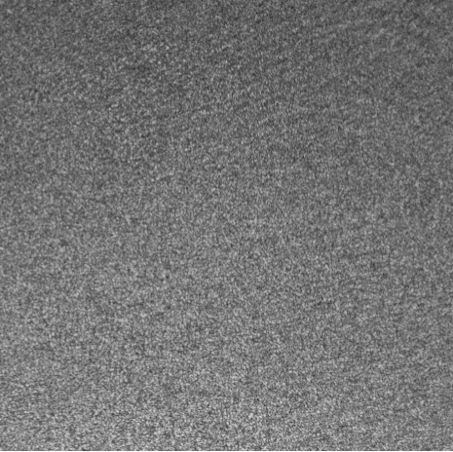
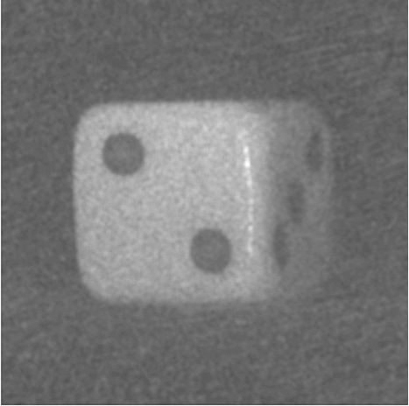
3D Hologram Information
And 2D Reconstructed Representation

Slide 5
Progress To Date
So far I have created a number of GNU Octave programs to reconstruct a hologram from a video stream
I have created a test suite to measure some of the limits of ffmpeg when applied to holograms
Planning
I have looked into extending the functionality of my test suite to measure the quality/size trade-off of different video codecs
I have investigated how to measure the trade-offs between hologram video size and reconstructed quality

Slide 6
Problems Encountered /Fundamental Challenges
Previous work that claimed to compress hologram videos have been shown to perform poorly, so I have had to start from scratch
in general image processing algorithms are not designed to take complex valued inputs
There is a large amount of documentation for ffmpeg which I have yet to understand fully, which has slowed my progress so far

Slide 7
Planned Next Steps
My very next step is to read the ffmpeg documentation and gain a full understanding of all parameters that can be passed in
Create more test cases to find the best compression/quality ratio of different video codecs
From these results I will then be able to begin applying this to video capture

